Slide 1
Automatic Day & Night Image Classification with Image Processing
Prepared by: Yildirim Kocoglu

Slide 2
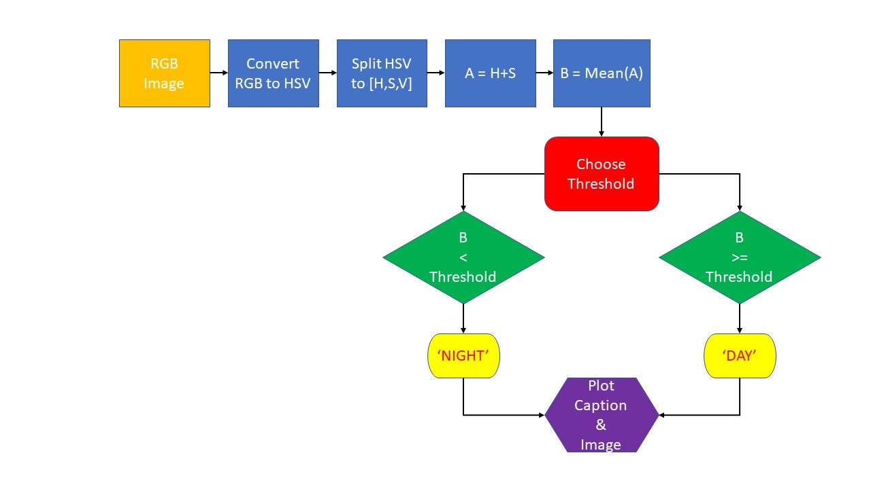
Algorithm Flowchart

Slide 3
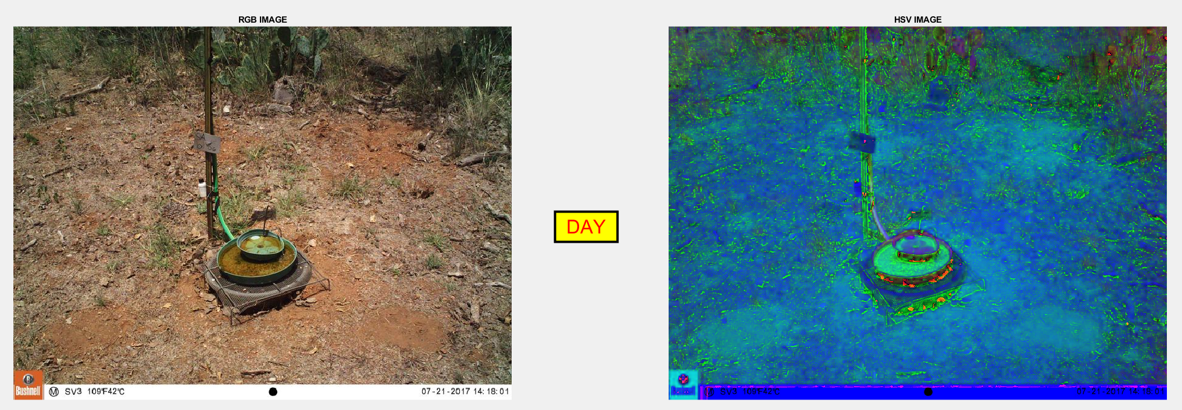
Example # 1: Day Image (Sunny)

Slide 4
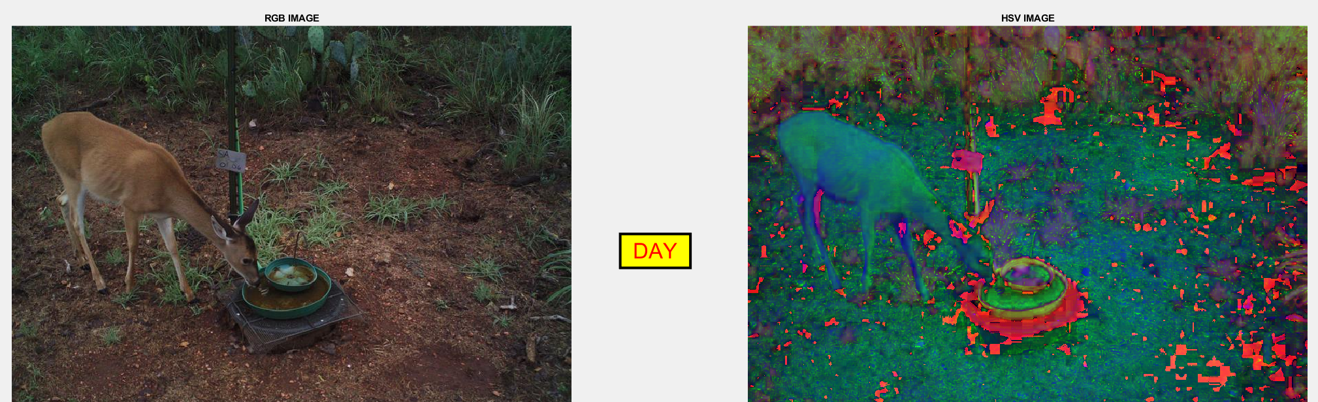
Example # 2: Day Image (Cloudy)

Slide 5
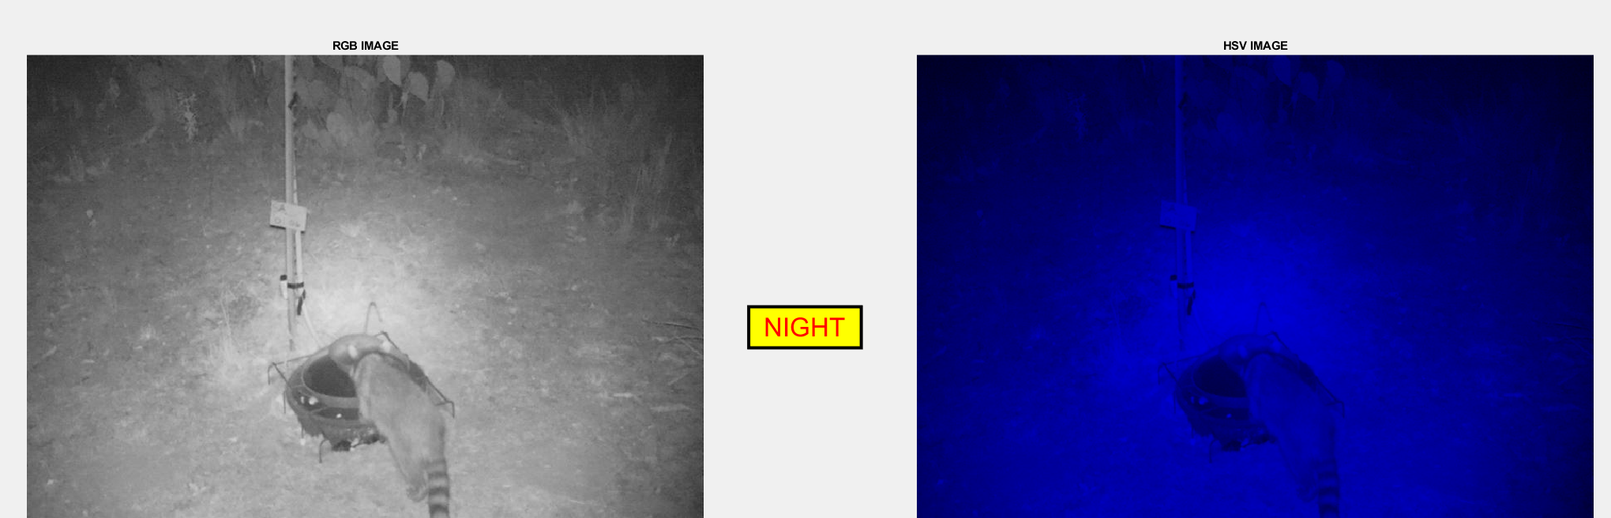
Example # 3: Night Image

Slide 6
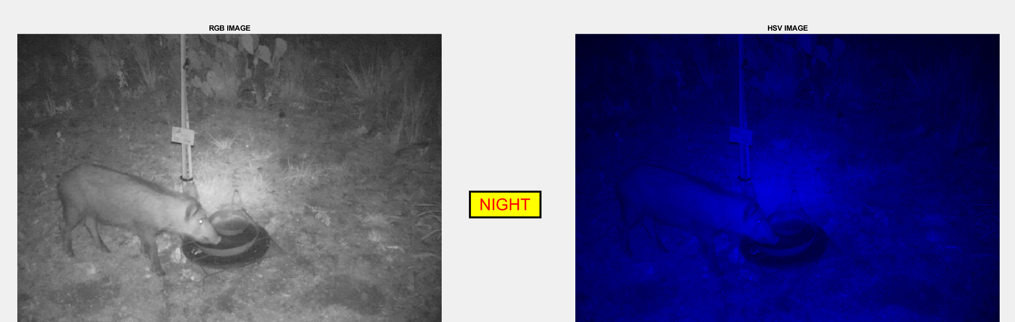
Example # 3: Night Image

